Slide 1
Morphological Operations (Digital Image Processing)
Faculty of Information Technology Ton Duc Thang University
August 2023

Slide 2
Morphological Operations
Image thresholding (binarization)
Example: Foreground extraction
Connected-components
Pixel neighborhoods
Region labeling
Region properties
Application: Blob-based motion detection
Morphological operations
Erosion/dilation/opening/closing
Applications
Python
OpenCV

Slide 3
Binary image processing
Binary images are common
Intermediate abstraction in a gray-scale/color image analysis system
Thresholding/segmentation
Presence/absence of some image property
Text and line graphics, document image processing
Representation of individual pixels as 0 or 1, convention:
foreground, object = 1 (white)
background = 0 (black)
Processing by logical functions is fast and simple
Shift-invariant logical operations on binary images: “morphological” image processing

Slide 4
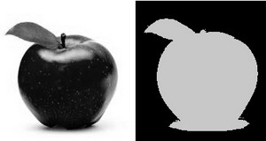
What is Thresholding?
The simplest binarization method
Application example:
Separate out regions of an image corresponding to objects which we want to analyze. This separation is based on the variation of intensity between the object pixels and the background pixels.
To differentiate the pixels we are interested in from the rest (which will eventually be rejected),
we perform a comparison of each pixel intensity value with respect to a threshold (determined according to the problem to solve).
Once we have separated properly the important pixels,
we can set them with a determined value to identify them (i.e. we can assign them a value of (black), (white) or any value that suits your needs).

Slide 5
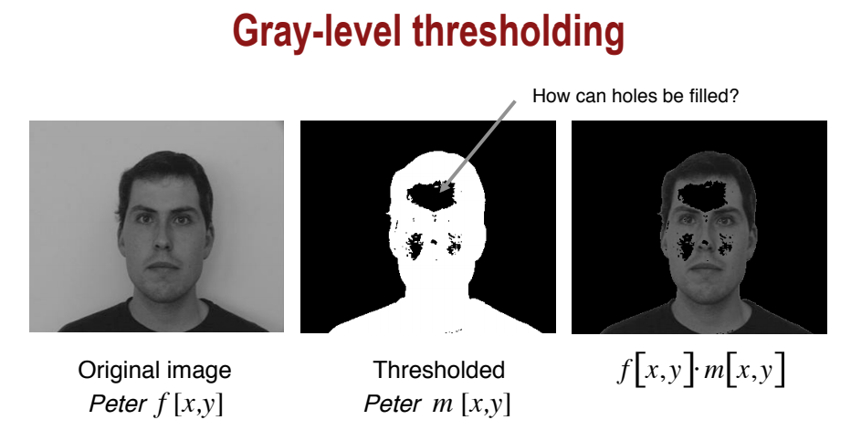
Thresholding

Slide 6
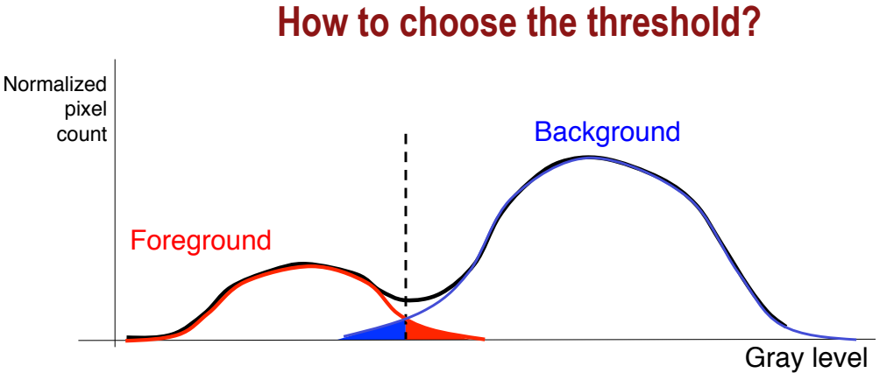
Thresholding

Slide 7
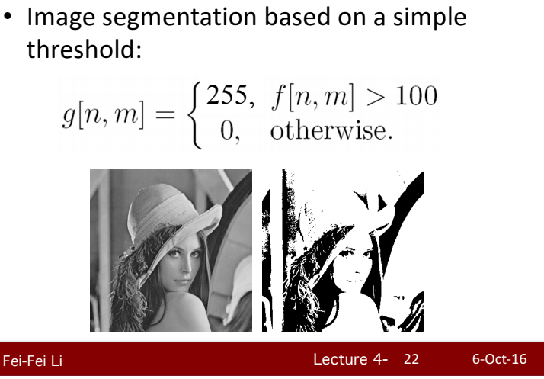

Slide 8
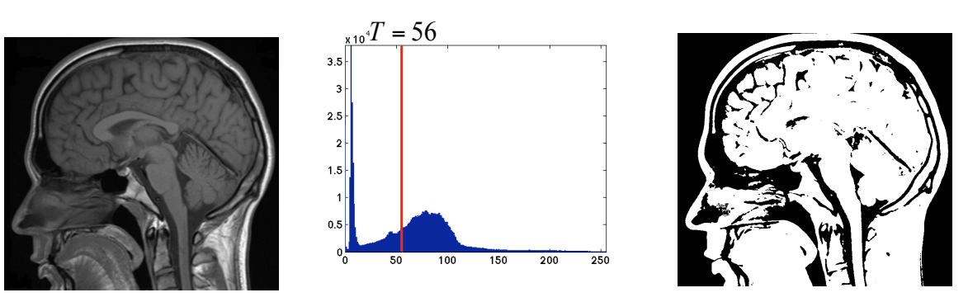
Thresholding

Slide 9

Thresholding

Slide 10
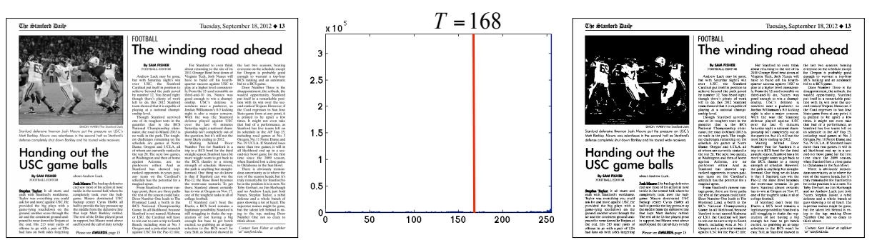
Thresholding

Slide 11
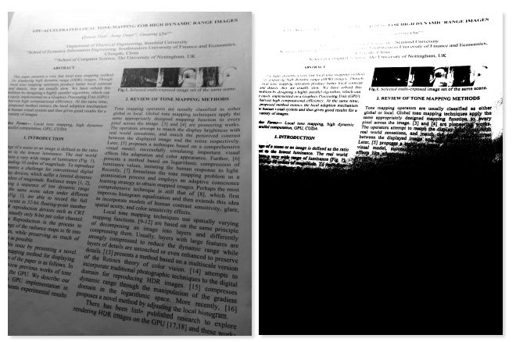
Thresholding
Sometimes, a global threshold does not work

Slide 12
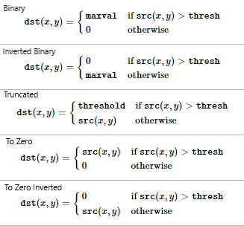
Image thresholding
Binary Thresholding
If pixel intensity is greater than the threshold, value set to maxval, else set to 0 (black)
Inverted Binary Thresholding
Inverted case of Binary Thresholding
Truncated Thresholding
If pixel intensity value is greater than threshold, it is truncated to the threshold. All other values remain the same.

Slide 13
Image thresholding
To-zero Thresholding
Pixel intensity is set to 0, for all the pixels intensity, less than the threshold value.
Inverted To-zero Thresholding
Inverted case of To-zero Thresholding.

Slide 14
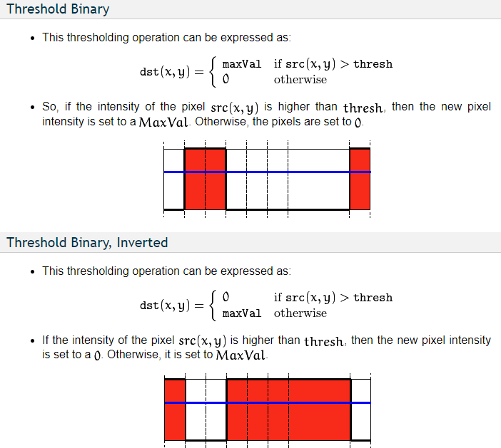

Slide 15
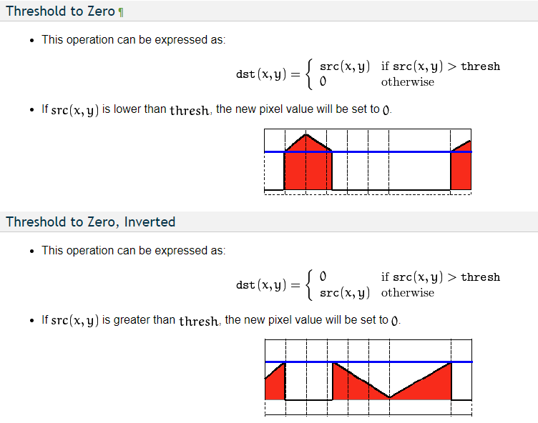

Slide 16
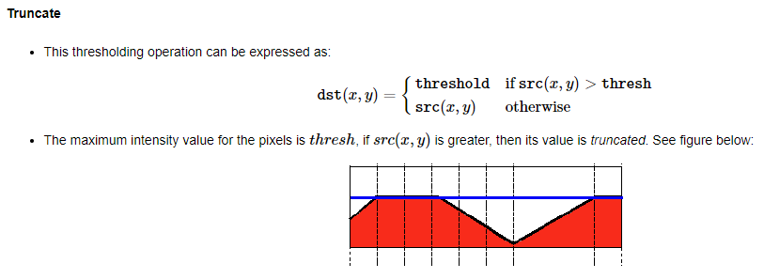
https://docs.opencv.org/3.4/db/d8e/tutorial_threshold.html

Slide 17
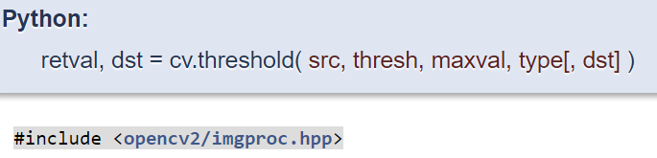
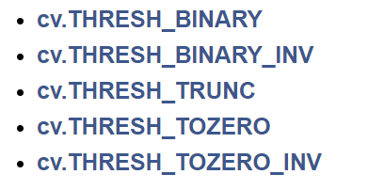
https://docs.opencv.org/4.x/d7/d4d/tutorial_py_thresholding.html

Slide 18
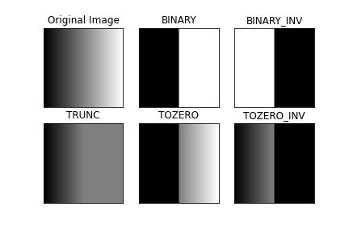
Thresholding examples
threshold = 127
maxVal = 255

Slide 19
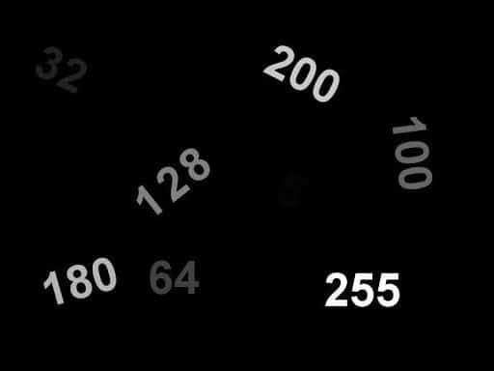
Input 1
The input image contains numbers written with intensity equal to the number itself. For ex., the pixel intensity of the number ‘200’ is 200, and the intensity of the number ‘32’ is 32. No wonder ‘32’ appears much darker than ‘200’.

Slide 20
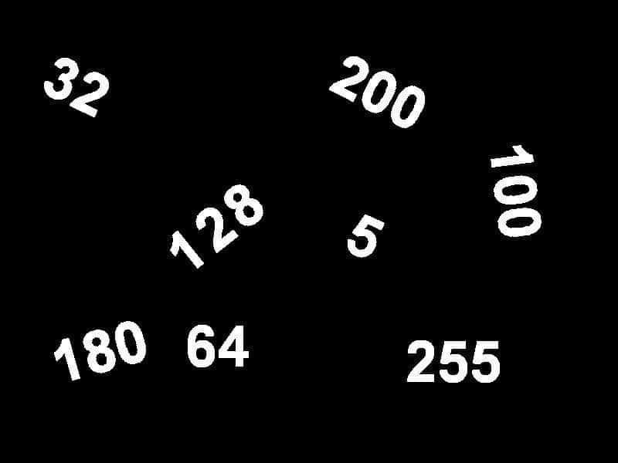
Ex .1a
For the “Input 1” image, apply thresholding methods to:
change all numbers to WHITE color (intensity = 255).
Binary thresholding with thresh = 0 and maxVal = 255

Slide 21
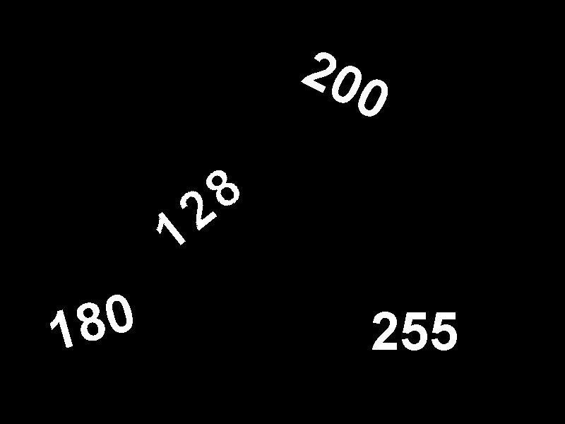
Ex .1b
change all numbers whose values are greater than or equal to 128 into WHITE color

Slide 22

Ex .1c
change all numbers into the Gray color (intensity = 128)

Slide 23
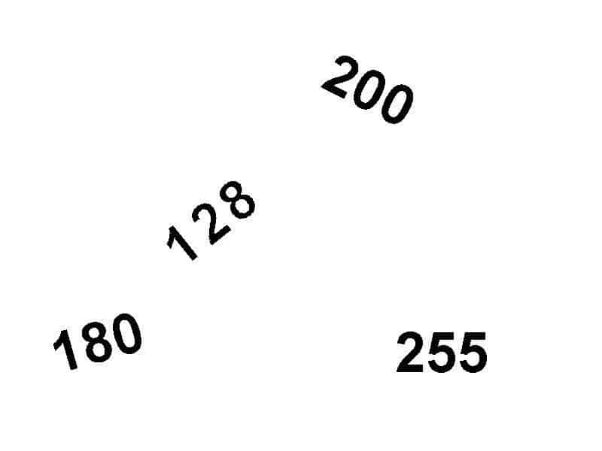
Ex .1d
change all numbers whose values are greater than or equal to 128 into BLACK color, and also change the background color to WHITE.

Slide 24
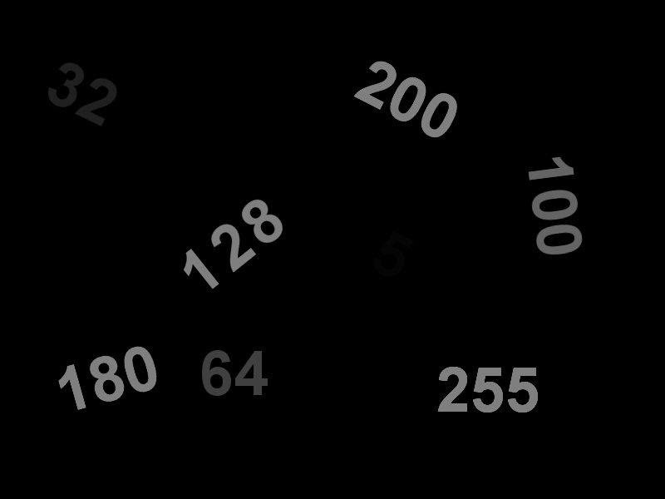
Ex .1e
change all numbers whose values are greater than 127 into the Gray color (intensity = 127), and other numbers are unchanged.

Slide 25
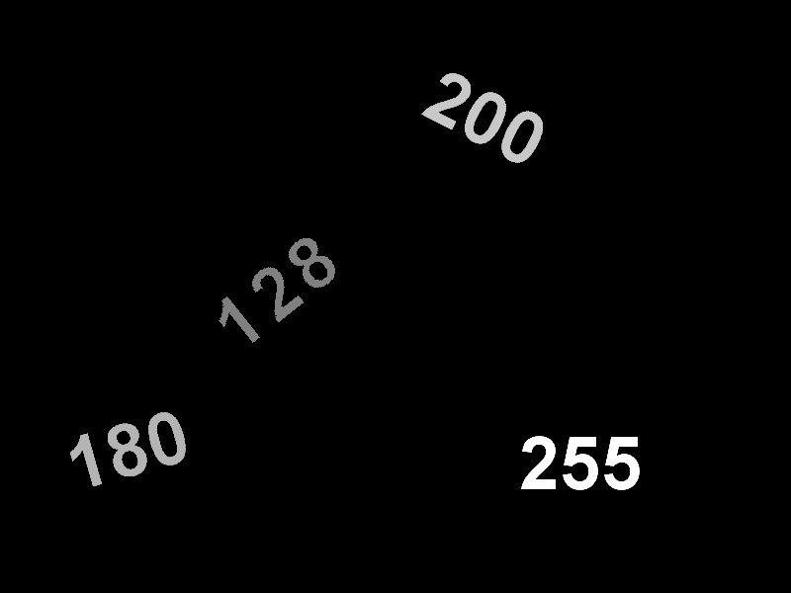
Ex .1f
Remove all numbers whose values are less than 128, and other numbers are remained.

Slide 26

Ex .1g
Remove all numbers whose values are greater than 127, and other numbers are remained.

Slide 27
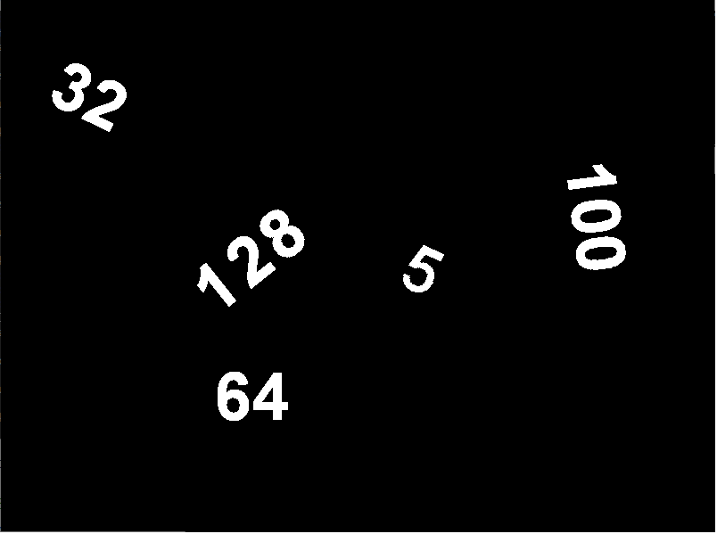
Ex .1h
Change numbers whose values are less than 180 into WHITE color.
Hints: Using different thresholding techniques.

Slide 28

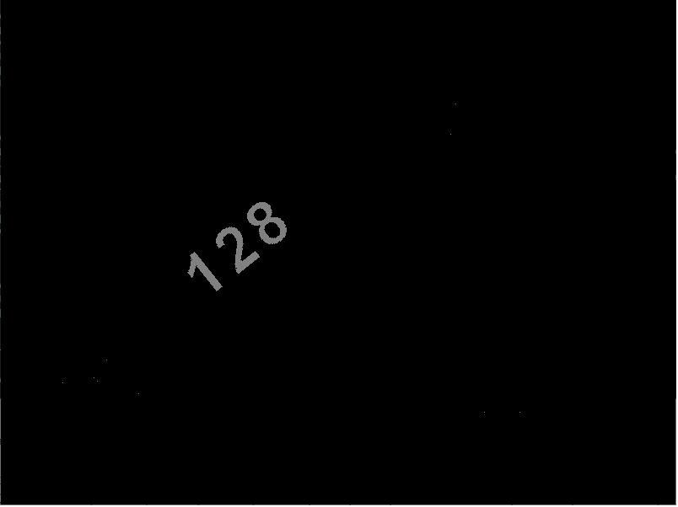
Ex .1i
Extract each number in the input image as in separated images.

Slide 29
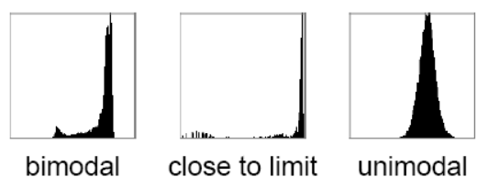
Otsu’s Thresholding
determines an optimal global threshold value from the image histogram
produces the appropriate results for bimodal images (histogram contains two clearly expressed peaks, which represent different ranges of intensity values)

Slide 30
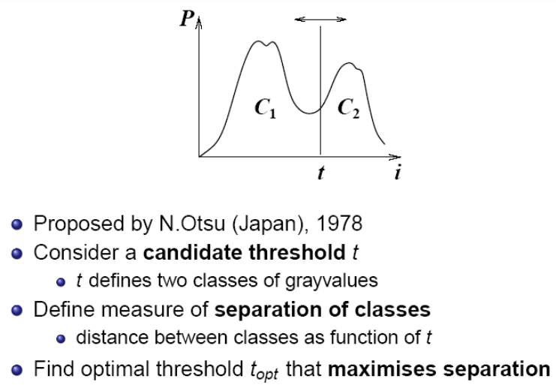
Otsu’s Thresholding (ct)
https://www.scribd.com/document/407105529/ME5286-Lecture9-pdf

Slide 31
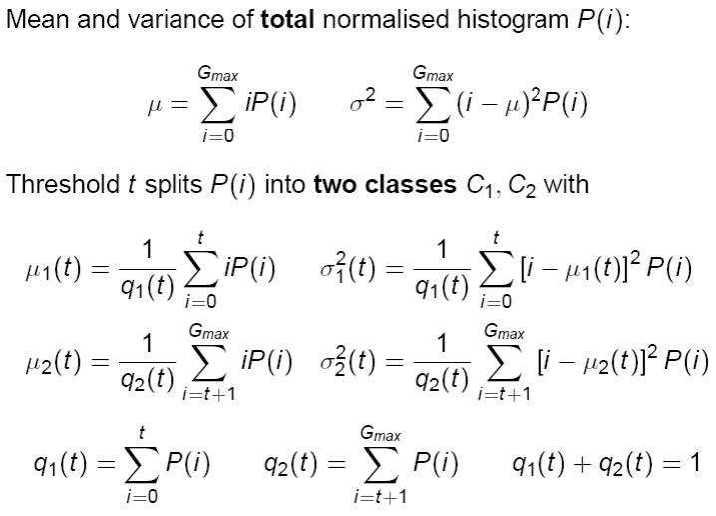
Otsu’s Thresholding (ct)
https://www.scribd.com/document/407105529/ME5286-Lecture9-pdf

Slide 32
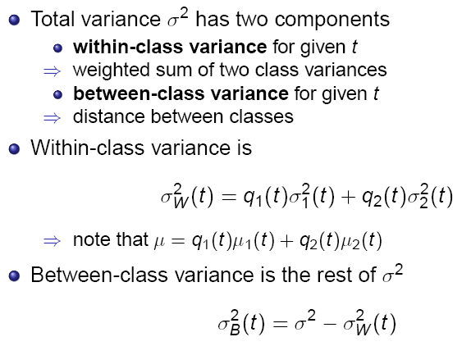
Otsu’s Thresholding (ct)
https://www.scribd.com/document/407105529/ME5286-Lecture9-pdf

Slide 33
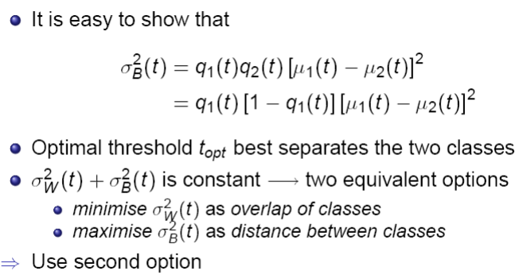
Otsu’s Thresholding (ct)
https://www.scribd.com/document/407105529/ME5286-Lecture9-pdf

Slide 34
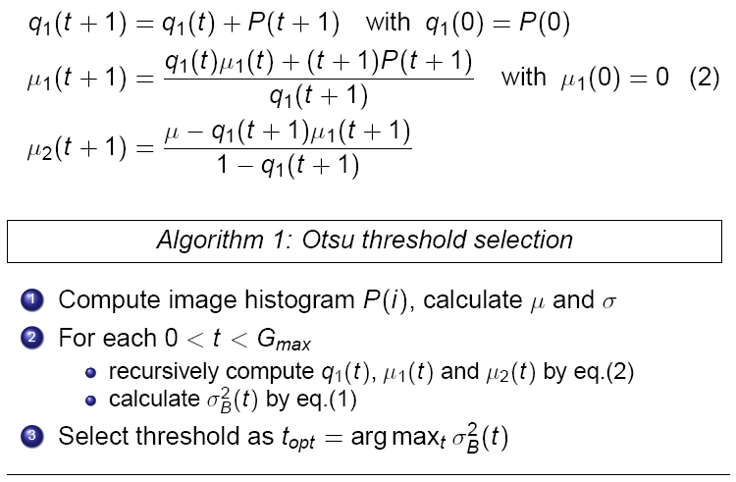
Otsu’s Thresholding (ct)
https://www.scribd.com/document/407105529/ME5286-Lecture9-pdf

Slide 35

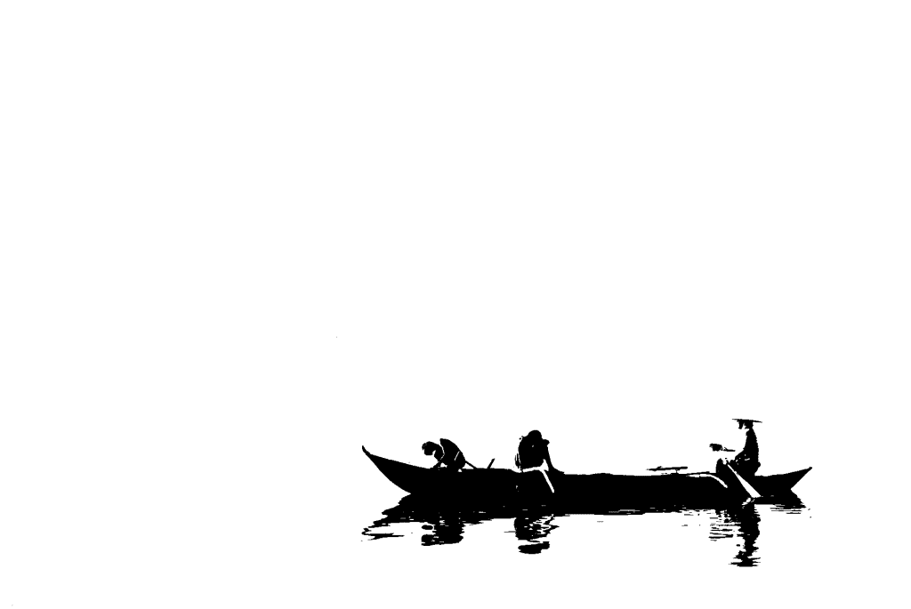
Otsu’s Thresholding (ct)
https://learnopencv.com/otsu-thresholding-with-opencv/

Slide 36
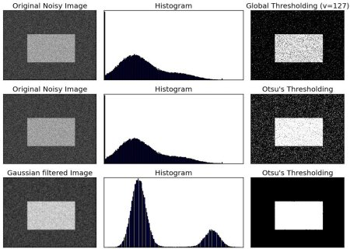
Otsu’s Thresholding (ct)

Slide 37
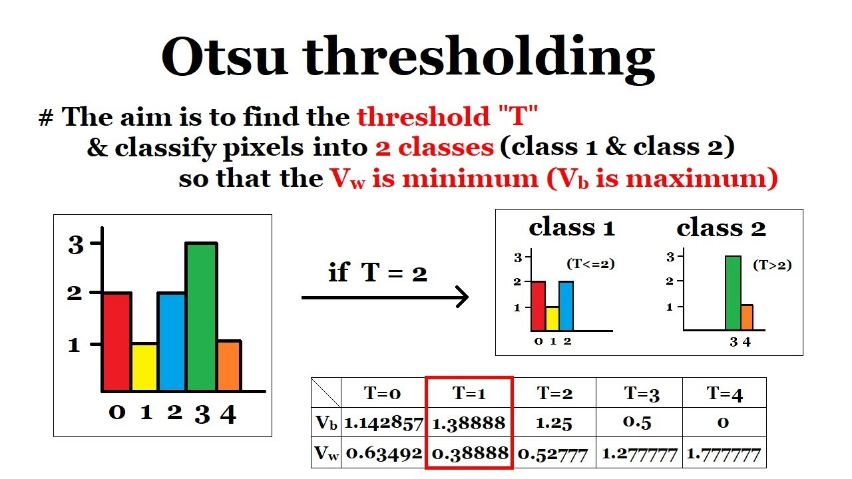
Otsu’s Thresholding (ct)
Ex. 2: Reproduce the resulted table.
https://www.youtube.com/watch?v=Ofi1Fn18YLc

Slide 38
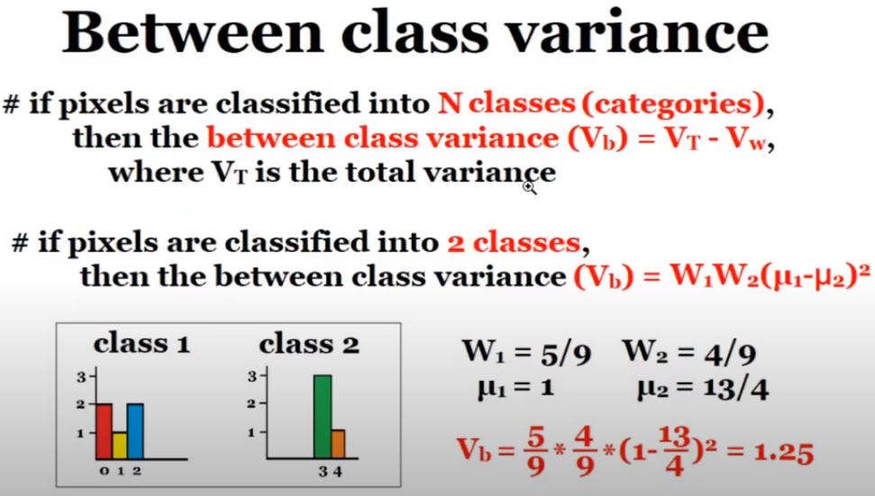
Otsu’s Thresholding

Slide 39
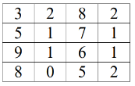
Ex. 3
Let The Following Image Be Given:
Determine The Threshold For Image Binarization Using The Otsu Method.

Slide 40
Adaptive Thresholding
A global threshold might not be good in all cases, e.g. if an image has different lighting conditions in different areas
Adaptive thresholding determines the threshold for a pixel based on a small region around it
get different thresholds for different regions of the same image which gives better results for images with varying illumination

Slide 41
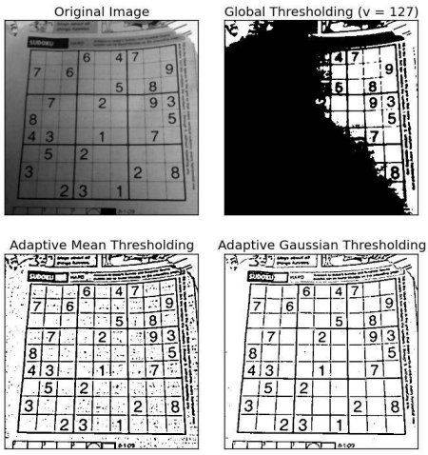
Adaptive Thresholding (ct)
https://docs.opencv.org/4.x/d7/d4d/tutorial_py_thresholding.html

Slide 42
Adaptive Thresholding (ct)
Parameters:
Threshold type: Must be either “Binary thresholding” or “inverted Binary thresholding”. This tells us what value to assign to pixels greater/less than the threshold.
maxValue: This is the value assigned to the pixels after thresholding. This depends on the thresholding type. If the type is “Binary thresholding”, all the pixels greater than the threshold are assigned this maxValue.
adaptive Method: This tells us how the threshold is calculated from the pixel neighborhood
MEAN_C : The threshold value is the mean of the neighbourhood area minus the constant C
GAUSSIAN_C : The threshold value is a gaussian-weighted sum of the neighbourhood values minus the constant C (read more in [1], [2], [3])
blockSize determines the size of the neighbourhood area.
C : Constant subtracted from the mean or weighted mean.

Slide 43
Adaptive Thresholding (ct)
Neighborhood size has to be large enough to cover sufficient foreground and background pixels
Choosing regions which are too large can violate the assumption of approximately uniform illumination
C constant is used to properly tune the threshold value
There may be situations where the mean value alone is not discriminating enough between the background and foreground — thus by adding or subtracting some value C, we can improve the results of our threshold.
For each pixel in the image:
Calculate the statistics (such as mean, median, etc.) from its neighbourhood. Its statistics minus the constant C will be the threshold value for that pixel.
Change the pixel value using the threshold

Slide 44
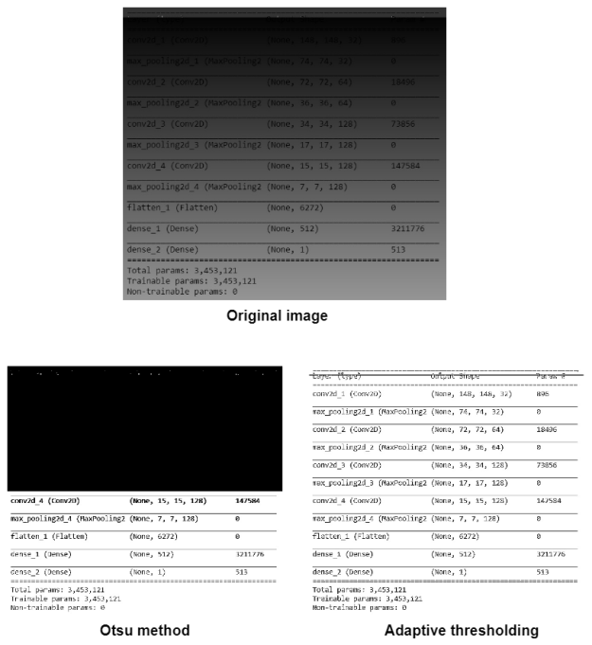
Adaptive Thresholding (ct)

Slide 45
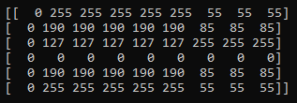
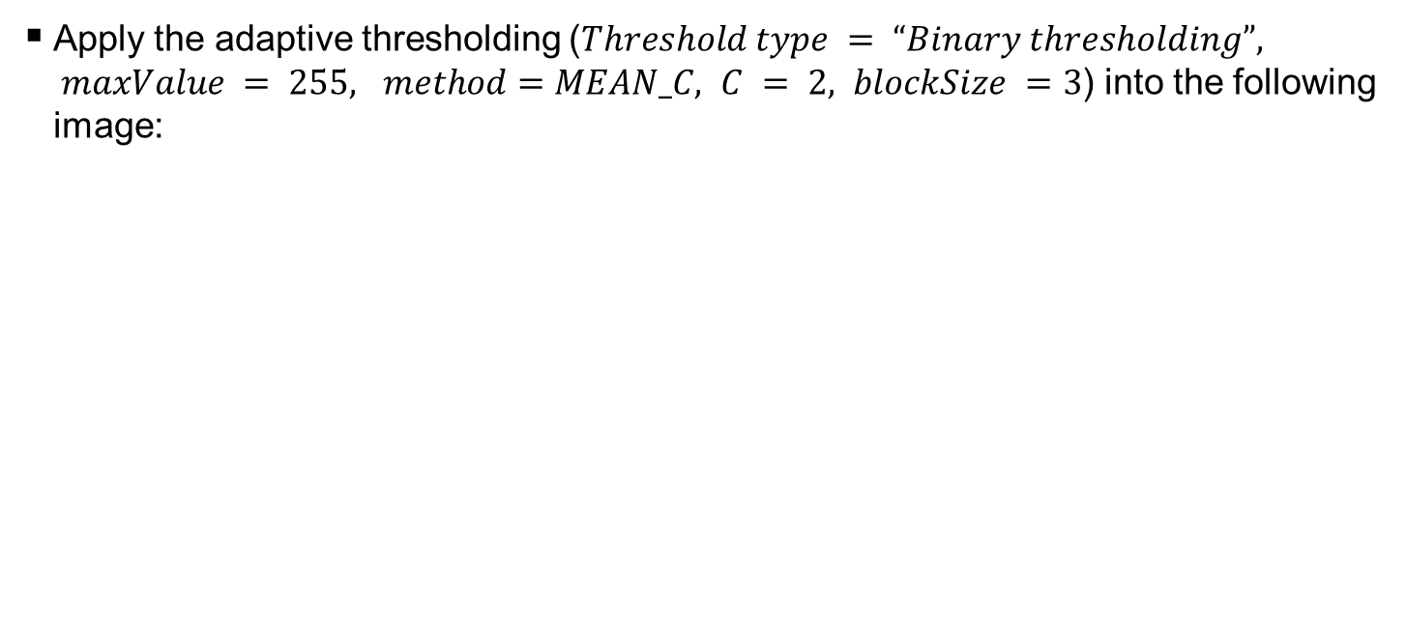
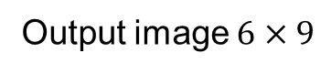
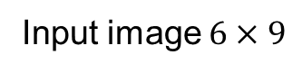
Ex. 4
Apply the adaptive thresholding ($Threshold type = “Binary thresholding”, maxValue = 255, method=MEAN_C, C = 2, blockSize =3$) into the following image:
Output image $6×9$
Input image $6×9$
0 | 255 | ? | ? | ? | ? | ? | 0 | 0
0 | 255 | ? | ? | ? | ? | ? | ? | ?
? | ? | ? | ? | ? | ? | ? | ? | ?
? | ? | ? | ? | ? | ? | ? | ? | ?
? | ? | ? | ? | ? | ? | ? | ? | ?
0 | 255 | ? | ? | ? | ? | ? | ? | ?

Slide 46

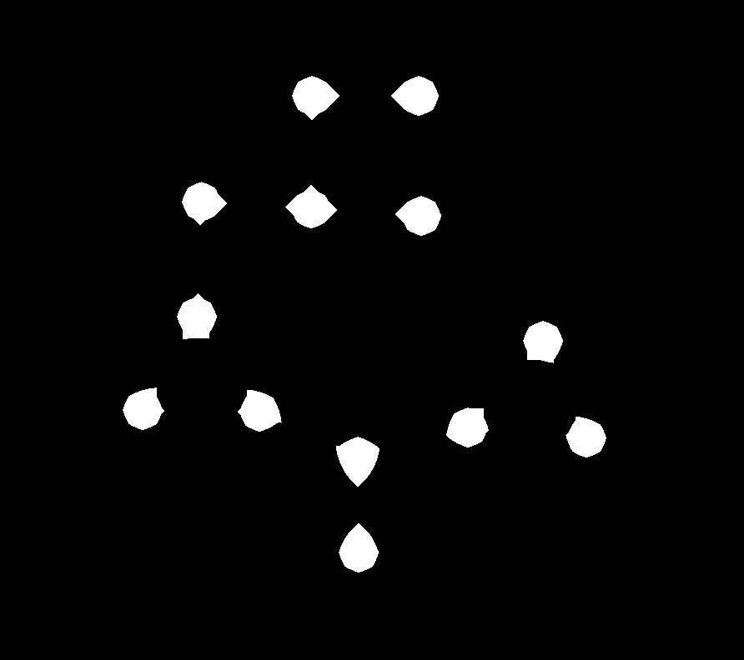
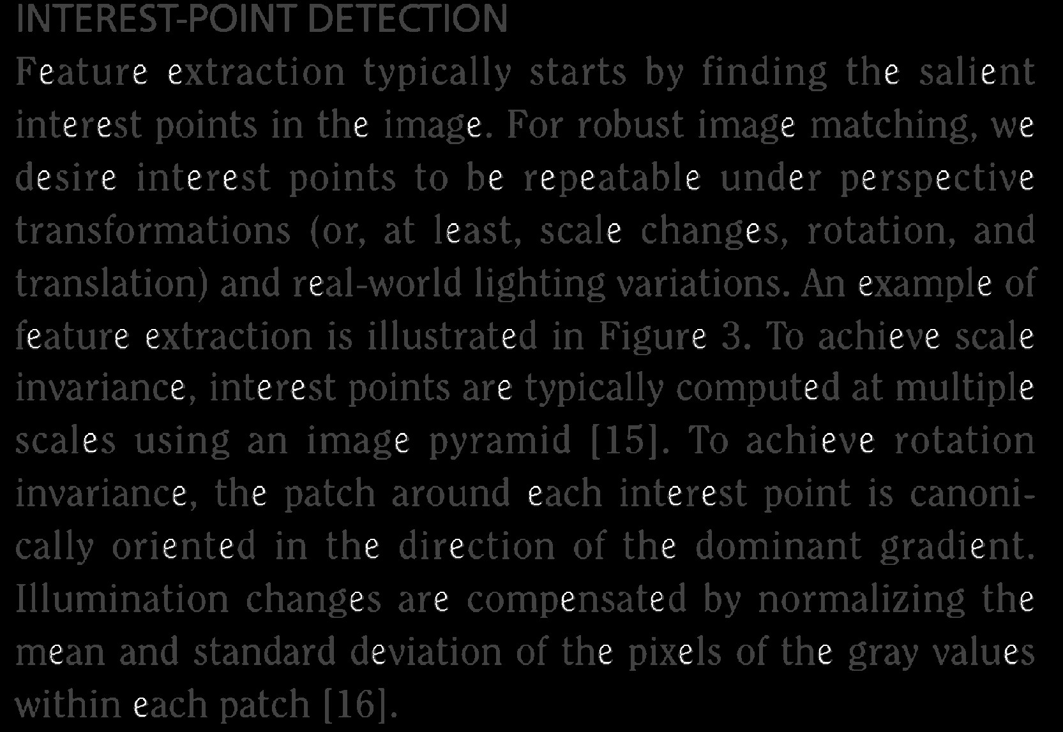
Morphological Image Processing
Binary dilation and erosion
Set-theoretic interpretation
Opening, closing, morphological edge detectors
Hit-miss filter
Morphological filters for gray-level images
Cascading dilations and erosions
Rank filters, median filters, majority filters

Slide 47
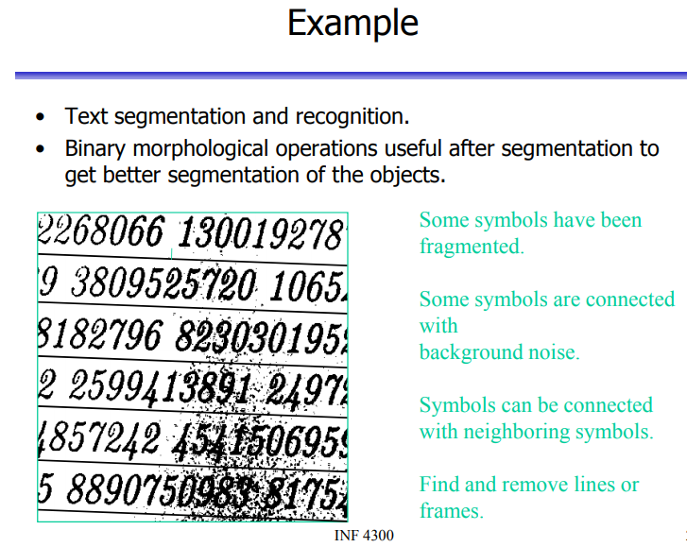

Slide 48
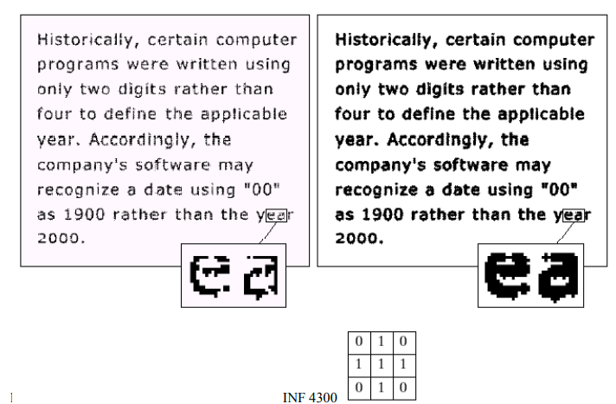
Morphological operations

Slide 49
Structure elements

Slide 50
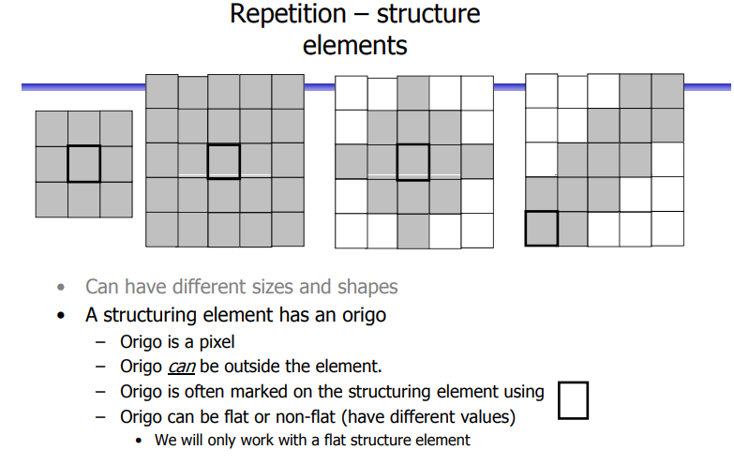

Slide 51
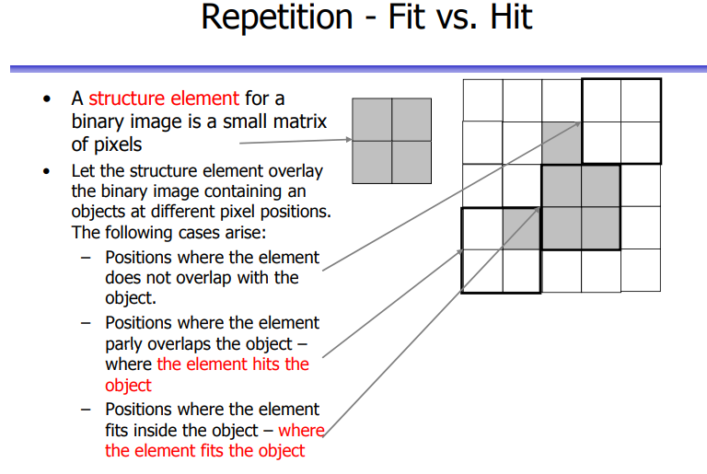

Slide 52
HIT vs FIT
https://www.cs.auckland.ac.nz/courses/compsci773s1c/lectures/ImageProcessing-html/topic4.htm
The structuring element is said to fit the image if, for each of its pixels set to 1, the corresponding image pixel is also 1.
Similarly, a structuring element is said to hit, or intersect, an image if, at least for one of its pixels set to 1 the corresponding image pixel is also 1.

Slide 53

Erosion example

Slide 54
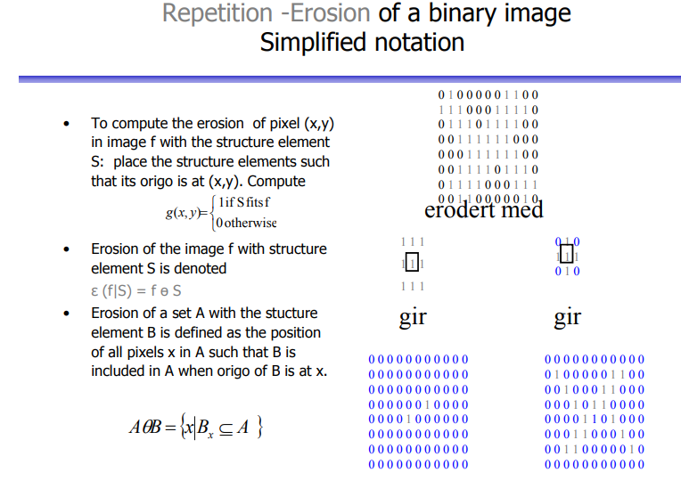

Slide 55
Erosion

Slide 56
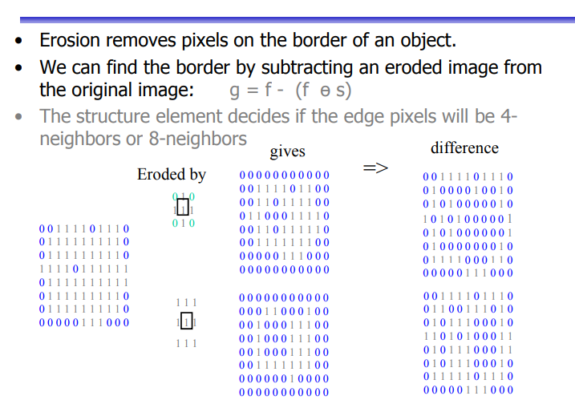

Slide 57
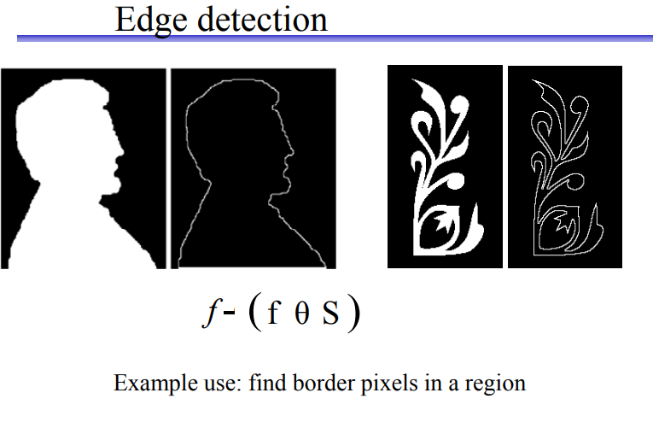

Slide 58



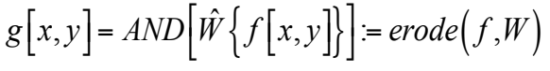
Binary erosion with square structuring element
Shrinks the size of 1-valued objects
Smoothens object boundaries
Removes peninsulas, fingers, and small objects
Original (701x781)
erosion with
3x3 structuring element
erosion with
7x7 structuring element

Slide 59

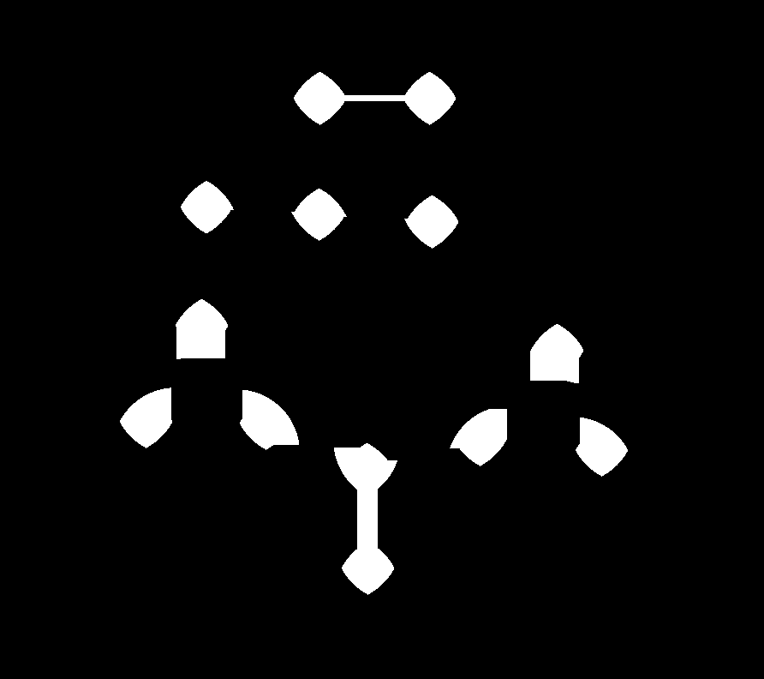

Example: blob separation/detection by erosion
Original binary image
Circles (792x892)
Erosion by 30x30 structuring element
Erosion by 70x70 structuring element
Erosion by 96x96 structuring element

Slide 60


Example: blob separation/detection by erosion
Original binary image
Circles (792x892)
Erosion by disk-shaped structuring element Diameter=15
Erosion by disk-shaped structuring element Diameter=35
Erosion by disk-shaped structuring element Diameter=48

Slide 61



Example: chain link fence hole detection
Original grayscale image
Fence (1023 x 1173)
Fence thresholded using Otsu’s method
Erosion with 151x151 “cross” structuring element

Slide 62



Ex. 5
Apply the erosion into the following image:
Input image $6×9$
Output image $6×9$
0 | 1 | 1 | 1 | 0 | 0 | 1 | 1 | 1
0 | 1 | 1 | 1 | 0 | 0 | 1 | 1 | 0
1 | 1 | 1 | 0 | 0 | 0 | 1 | 1 | 1
1 | 1 | 1 | 0 | 0 | 1 | 1 | 1 | 0
1 | 1 | 1 | 0 | 0 | 1 | 1 | 1 | 0
0 | 1 | 1 | 1 | 1 | 1 | 1 | 1 | 0
0 | 0 | 1 | 0 | ? | ? | ? | ? | ?
0 | 0 | 1 | 0 | ? | ? | ? | ? | ?
? | ? | ? | ? | ? | ? | ? | ? | ?
? | ? | ? | ? | ? | ? | ? | ? | ?
? | ? | ? | ? | ? | ? | ? | ? | ?
? | ? | ? | ? | ? | ? | ? | ? | ?
Kernel (S) = $\begin{matrix}0 & 1 & 0 \\ 1 & 1 & 1 \\ 0 & 1 & 0\end{matrix}$

Slide 63

Dilation example

Slide 64


Slide 65
Dilation

Slide 66


Slide 67


Slide 68



Binary dilation with square structuring element
Expands the size of 1-valued objects
Smoothes object boundaries
Closes holes and gaps
dilation with
3x3 structuring element
dilation with
7x7 structuring element
Original (701x781)

Slide 69
Ex. 6
Apply the dilation into the following image:
Input image $6×9$
Output image $6×9$
0 | 0 | 1 | 1 | 0 | 0 | 1 | 1 | 1
0 | 0 | 0 | 1 | 0 | 0 | 1 | 1 | 0
1 | 0 | 1 | 0 | 0 | 0 | 1 | 0 | 1
0 | 0 | 1 | 0 | 0 | 0 | 1 | 0 | 0
0 | 0 | 1 | 0 | 0 | 0 | 1 | 0 | 0
0 | 0 | 1 | 1 | 0 | 0 | 1 | 0 | 0
0 | 1 | 1 | 1 | ? | ? | ? | ? | ?
1 | 0 | 1 | 1 | ? | ? | ? | ? | ?
? | ? | ? | ? | ? | ? | ? | ? | ?
? | ? | ? | ? | ? | ? | ? | ? | ?
? | ? | ? | ? | ? | ? | ? | ? | ?
? | ? | ? | ? | ? | ? | ? | ? | ?
Kernel (S) = $\begin{matrix}0 & 1 & 0 \\ 1 & 1 & 1 \\ 0 & 1 & 0\end{matrix}$

Slide 70

Relationship between dilation and erosion

Slide 71

Opening and closing
Goal: smoothing without size change
Open filter: $open(f ,W)= dilate(erode( f ,W),W)$
Close filter: $close(f ,W)=erode(dilate( f ,W),W)$
Open filter and close filter are biased
Open filter removes small 1-regions
Close filter removes small 0-regions
Unbiased size-preserving smoothers
close − open( f ,W ) = close(open( f ,W ),W )
open − close( f ,W ) = open(close( f ,W ),W )
close-open and open-close are duals, but not inverses of each other.

Slide 72


Slide 73




Small hole removal by closing
Original binary mask
Dilation 10x10
Closing 10x10
Difference to original mask

Slide 74



Ex. 7
Apply the opening into the following image:
Input image $9×9$
Output image $9×9$
0 | 0 | 0 | 0 | 0 | 0 | 0 | 0 | 0
0 | 1 | 1 | 1 | 1 | 1 | 1 | 0 | 0
0 | 1 | 1 | 1 | 1 | 1 | 1 | 0 | 0
0 | 1 | 1 | 1 | 0 | 0 | 0 | 0 | 0
0 | 1 | 0 | 1 | 0 | 1 | 0 | 0 | 0
0 | 1 | 1 | 1 | 0 | 0 | 0 | 0 | 0
0 | 1 | 1 | 1 | 0 | 0 | 0 | 0 | 0
0 | 1 | 1 | 1 | 1 | 1 | 1 | 0 | 0
0 | 1 | 1 | 1 | 1 | 1 | 1 | 0 | 0
Kernel (S):
$$\begin{matrix}0 & 1 & 0 \\ 1 & 1 & 1 \\ 0 & 1 & 0\end{matrix}$$
? | ? | ? | ? | ? | ? | ? | ? | ?
? | ? | ? | ? | ? | ? | ? | ? | ?
? | ? | ? | ? | ? | ? | ? | ? | ?
? | ? | ? | ? | ? | ? | ? | ? | ?
? | ? | ? | ? | ? | ? | ? | ? | ?
? | ? | ? | ? | ? | ? | ? | ? | ?
? | ? | ? | ? | ? | ? | ? | ? | ?
? | ? | ? | ? | ? | ? | ? | ? | ?
? | ? | ? | ? | ? | ? | ? | ? | ?

Slide 75
Ex. 8
Apply the closing into the following image:
Input image $9×9$
Output image $9×9$
0 | 0 | 0 | 0 | 0 | 0 | 0 | 0 | 0
0 | 1 | 1 | 1 | 1 | 1 | 1 | 0 | 0
0 | 1 | 1 | 1 | 1 | 1 | 1 | 0 | 0
0 | 1 | 1 | 1 | 0 | 0 | 0 | 0 | 0
0 | 1 | 0 | 1 | 0 | 1 | 0 | 0 | 0
0 | 1 | 1 | 1 | 0 | 0 | 0 | 0 | 0
0 | 1 | 1 | 1 | 0 | 0 | 0 | 0 | 0
0 | 1 | 1 | 1 | 1 | 1 | 1 | 0 | 0
0 | 1 | 1 | 1 | 1 | 1 | 1 | 0 | 0
Kernel (S):
$$\begin{matrix}0 & 1 & 0 \\ 1 & 1 & 1 \\ 0 & 1 & 0\end{matrix}$$
? | ? | ? | ? | ? | ? | ? | ? | ?
? | ? | ? | ? | ? | ? | ? | ? | ?
? | ? | ? | ? | ? | ? | ? | ? | ?
? | ? | ? | ? | ? | ? | ? | ? | ?
? | ? | ? | ? | ? | ? | ? | ? | ?
? | ? | ? | ? | ? | ? | ? | ? | ?
? | ? | ? | ? | ? | ? | ? | ? | ?
? | ? | ? | ? | ? | ? | ? | ? | ?
? | ? | ? | ? | ? | ? | ? | ? | ?

Slide 76
Ex. 9
Apply the opening and then closing into the following image:
Input image $9×9$
Output image $9×9$
0 | 0 | 0 | 0 | 0 | 0 | 0 | 0 | 0
0 | 1 | 1 | 1 | 1 | 1 | 1 | 0 | 0
0 | 1 | 1 | 1 | 1 | 1 | 1 | 0 | 0
0 | 1 | 1 | 1 | 0 | 0 | 0 | 0 | 0
0 | 1 | 0 | 1 | 0 | 1 | 0 | 0 | 0
0 | 1 | 1 | 1 | 0 | 0 | 0 | 0 | 0
0 | 1 | 1 | 1 | 0 | 0 | 0 | 0 | 0
0 | 1 | 1 | 1 | 1 | 1 | 1 | 0 | 0
0 | 1 | 1 | 1 | 1 | 1 | 1 | 0 | 0
Kernel (S):
$$\begin{matrix}0 & 1 & 0 \\ 1 & 1 & 1 \\ 0 & 1 & 0\end{matrix}$$
? | ? | ? | ? | ? | ? | ? | ? | ?
? | ? | ? | ? | ? | ? | ? | ? | ?
? | ? | ? | ? | ? | ? | ? | ? | ?
? | ? | ? | ? | ? | ? | ? | ? | ?
? | ? | ? | ? | ? | ? | ? | ? | ?
? | ? | ? | ? | ? | ? | ? | ? | ?
? | ? | ? | ? | ? | ? | ? | ? | ?
? | ? | ? | ? | ? | ? | ? | ? | ?
? | ? | ? | ? | ? | ? | ? | ? | ?

Slide 77




Morphological edge detectors

Slide 78





Recognition by erosion
Binary image f
1400
2000
Structuring element W
44
34

Slide 79
Recognition by erosion
Structuring element W
44
34

Slide 80


Recognition by erosion
Binary image f
1400
2000
Structuring element W
62
18

Slide 81

Recognition by erosion
Structuring element W
62
18

Slide 82





Hit-miss filter
Binary image f
1400
2000
Structuring element V
Structuring element W
62
62
18
18

Slide 83

Hit-miss filter
Structuring element V
62
18
Structuring element W
62
18

Slide 84
Set operations on binary images: (from left to right ) (1) a binary image f, (2) a binary image g, (3) the complement f^{c} of f, (4) the intersection f ∩ g, and (5) the union f ∪ g

Slide 85

Dilation/erosion for gray-level images
Explicit decomposition into threshold sets not required in practice

Slide 86
Dilation in Grascale image – Ex. 10

Slide 87

1-d illustration of erosion and dilation
Structuring element length =
——Dilation
——Erosion
——Original
Structuring element: horizontal line
Amplitude
Sample no.

Slide 88



Image example
Original 394 x 305
Dilation 10x10 square
Erosion 10x10 square

Slide 89





Flat dilation with different structuring elements
Original
Diamond
Disk
20 degree line
9 points
2 horizontal lines

Slide 90






Example: counting coins
thresholded
1 connected component
Original
20 connected components
dilation
thresholded after dilation

Slide 91

Example: chain link fence hole detection
Original grayscale image
Fence (1023 x 1173)
Flat erosion with 151x151 “cross” structuring element
Binarized by Thresholding

Slide 92




Morphological edge detector
original f
dilation g
g − f
g − f
thresholded
|g-f |

Slide 93




Cascaded dilations
dilate( f , w₁ ) dilate( f , w₁, w₂ )
f
dilate( f , w₁, w₂ , w₃ )

Slide 94

Cascaded erosions
Cascaded erosions can be lumped into single erosion
New structuring element (SE) is not the erosion of one SE by the other, but dilation.

Slide 95
References
https://docs.opencv.org/4.x/d7/d1b/group__imgproc__misc.html#gaa42a3e6ef26247da787bf34030ed772c
https://www.geeksforgeeks.org/apply-a-gauss-filter-to-an-image-with-python/
https://theailearner.com/tag/adaptive-thresholding/
https://dsp.stackexchange.com/questions/54375/how-to-approximate-gaussian-kernel-for-image-blur
https://docs.opencv.org/

